Slide 1
When memes are mean:
Predicting dark humor in internet memes
Jessica
2020/3/5

Slide 2
Dark humor
Also known as gallows humor, is a comic style that makes light of subject matter that is generally considered taboo, particularly subjects that are normally considered serious or painful to discuss. (Wikipedia)

Slide 3
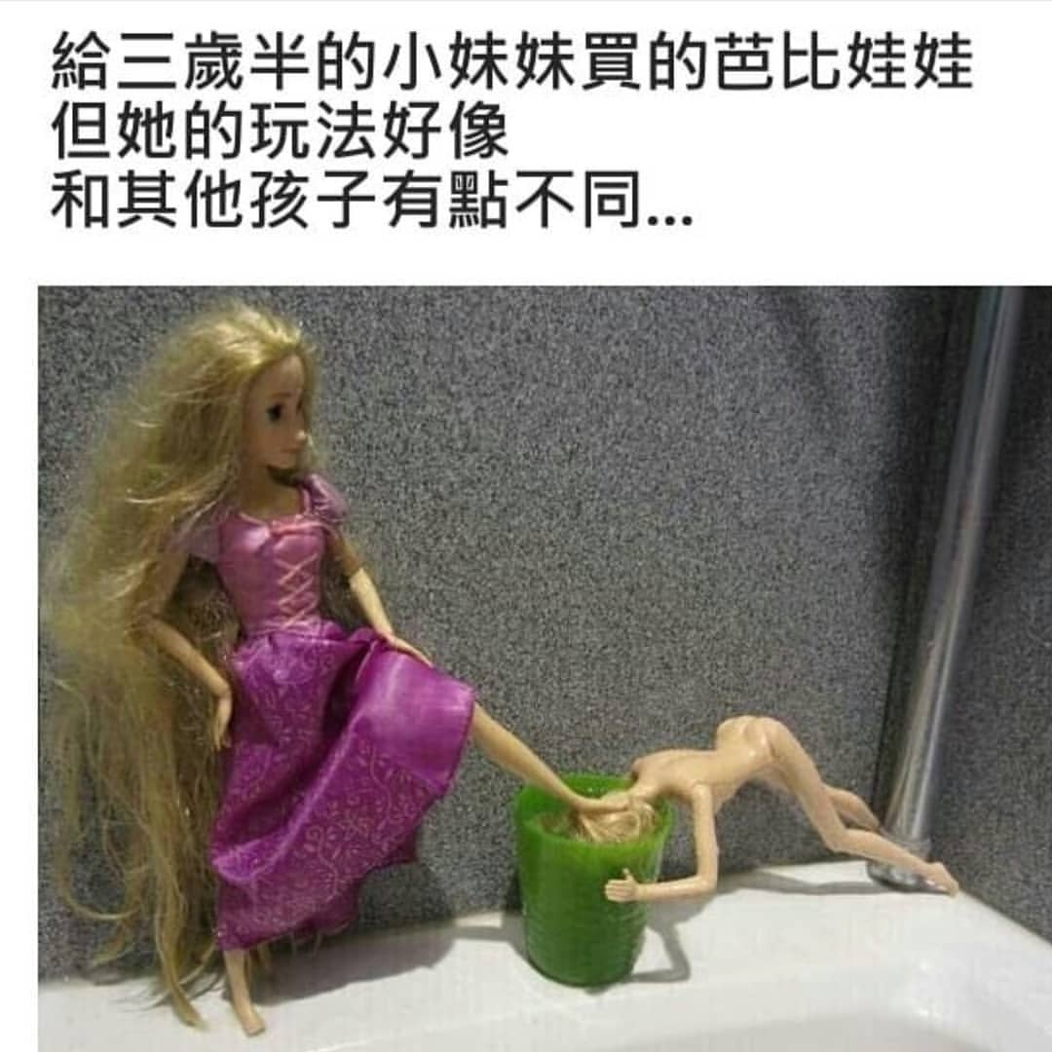
Dark humor memes: text-image relationship
Incongruity:
neutral image
+negative text
negative image +neutral text
Notes:
圖文之間的落差，incongruity 幽默理論
有時候在看一個meme的時候，如果只單看文字或是圖片，可能無法讓你想要笑

Slide 4
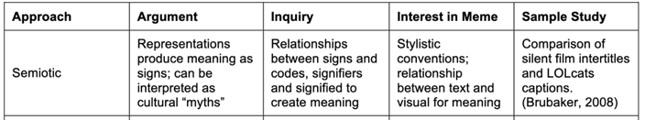
Framework: semiotics
What is being signified (所指) by the image and the caption → idiomatic meaning
The Semiotic Taxonomy:
The relationship between what is signified by the respective modalities, their semiotics.
Notes:
所以我們在研究梗圖的圖文關係的時候，如果單純只是研究圖文之間”literal”的關係，會無法掌握梗圖笑點在哪，必須更深入的去看文字和圖片背後“所指”代表的意義。

Slide 5
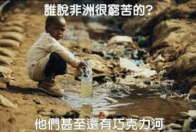
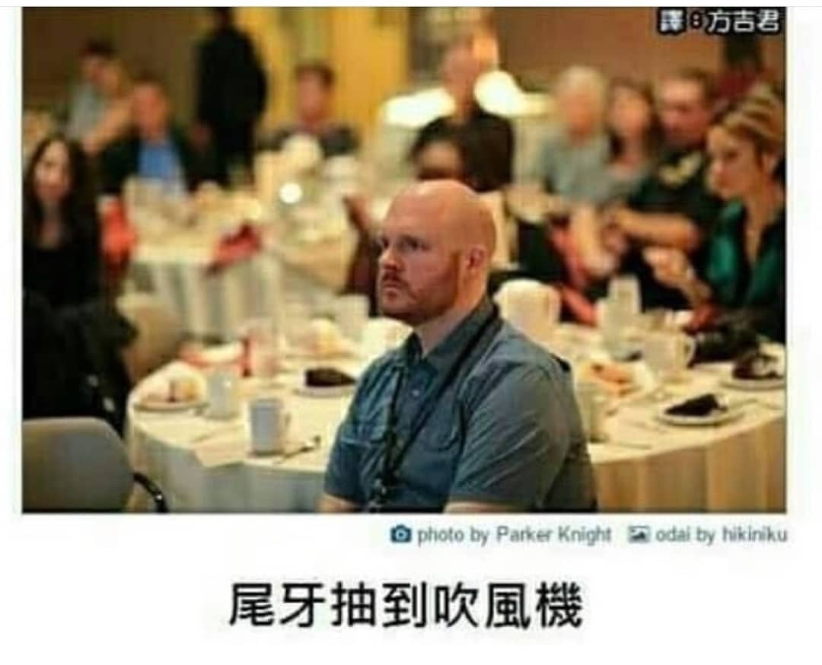
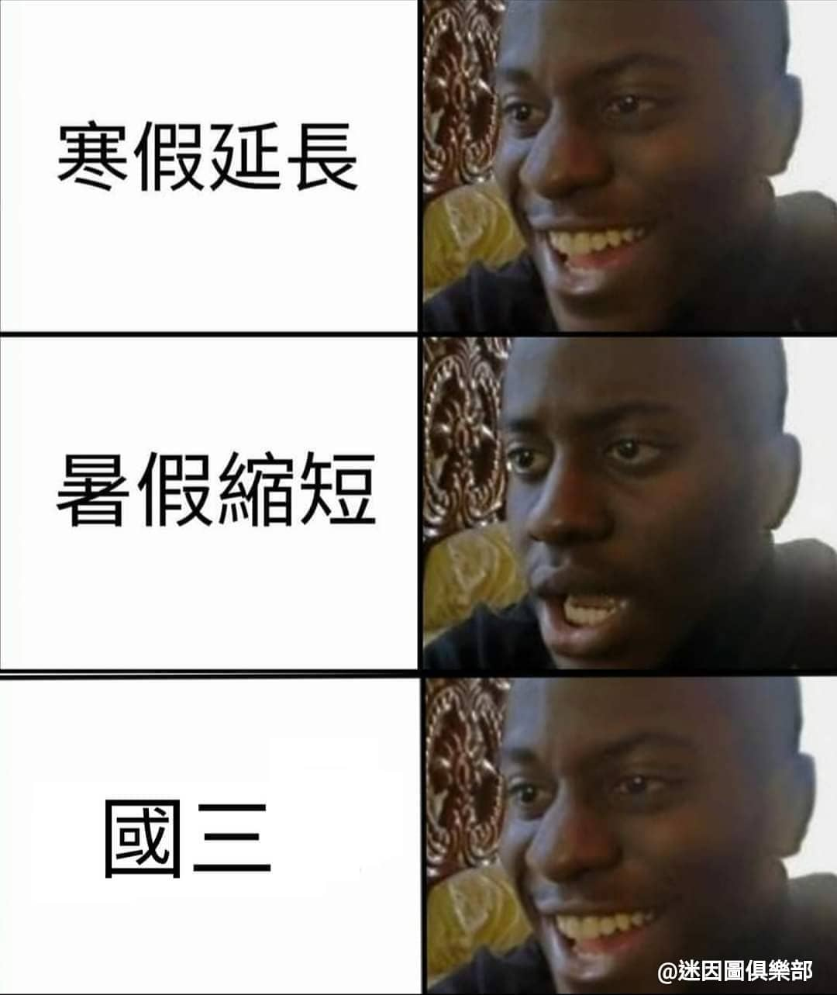
Framework: semiotics
Divergent
Complementary
Uncorrelated
Notes:
Divergent: 圖文之間呈現antonym 關係
Complementary:有傳達相同意義的部分，也有各自沒有傳達的部分(笑點所在)
Uncorrelated: unrelated: focus is on the image, the caption is unlrelated to it
透過標記梗圖圖文semiotics 之間的關係，希望能分類出safe humor 跟 dark humor

Slide 6
Framework: computational model
Computational approaches to multi-modal document understanding:
A computational model that detect complex relationships between text and image and how they cue humor and offensive content in memes
Multimodal embeddings:
(a) Image embeddings: ResNet-18 network pre-trained on ImageNet
(b) Text embeddings: word2vec and pre-trained character-based contextual embeddings (ELMo)
(c) Image+ Text: simple fusion strategy that first linearly projects encoded vectors from both the modalities in the same embedding space and then adds the two vectors
Notes:
講目的：電腦理解圖文關係、預測梗圖裡的幽默

Slide 7
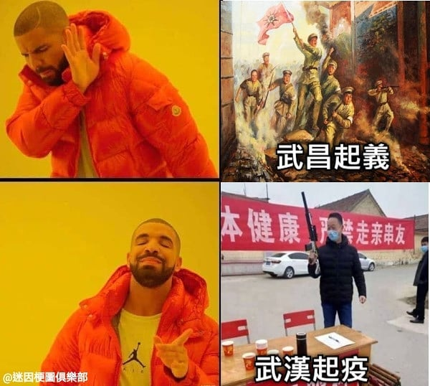
Framework: computational model
Computational approaches to multi-modal document understanding:
Output predicted probabilities for the type of humor (dark humor & “safe” humor)
Humor:
Safe humor: 0.75
Dark humor: 0.25
Humor:
Safe humor: 0.35
Dark humor: 0.65
Notes:
計算梗圖的黑色幽默分數
Semiotics+Embeddings-->預測梗圖的dark humor (political incorrect) 分數

Slide 8
4/30 目前進度與規劃
Memes Text+Image Embeddings (1000)
Safe humor memes (500) & Dark humor memes (500)
OCR+template_name → sentence embedding 512d (Sentence Transformers: Sentence Embeddings using multilingual BERT)(Pypi)
Image data → pic2vec (model選擇:squeezenet, Resnet50, xception...)
Why R2 is negative?
Improve Model: Lasso 和 Ridge Regression
Verbal dark humor features (Annox): sentiment score, list of profanity words, list of porn words, 1st /2 nd pronouns (Ahuja et al. 2018)
Sample Outputs
SemEval2020

Slide 9
 | Model 1 (using SqueezeNet) |  | Model 2 (using Xception) |  | Model 3 (using resnet50)
 | R-squared | Root mean squared error [MSE] | R-squared | Root mean squared error[MSE] | R-squared | Root mean squared error[MSE]
OCR | 0.86 | 0.19[0.036]
Template_name(TM) | 0.78 | 0.23[0.05]
Pic2vec(p2v) | 0.35 | 0.40[0.16] | 0.65 | 0.29[0.08] | 0.69 | 0.28[0.07]
OCR+TM | 0.96 | 0.10[0.01]
OCR+p2v | 0.90 | 0.16[0.02] | 0.96 | 0.10[0.01] | 0.93 | 0.14[0.01]
OCR+TM+p2v | 0.93 | 0.13[0.01] | 0.82 | 0.21[0.04] | 0.91 | 0.15[0.02]
mlp = neural_network.MLPRegressor(hidden_layer_sizes=(100,100), activation="relu",solver='adam', alpha=0.0001, batch_size='auto', learning_rate="constant", learning_rate_init=0.01, power_t=0.5, max_iter=1000,tol=1e-4)
Notes:
scikit-learn Training score

Slide 10
OCR,TM, P2V in MLPclassifier
 | Model 1 (using SqueezeNet) | Model 2 (using Xception) | Model 3 (using resnet50)
 | ACC | ACC | ACC
OCR | 0.7205
Template_name(TM) | 0.6756
Pic2vec(p2v) | 0.6448 | 0.6607 | 0.6547
TM+P2V | 0.6886 | 0.6926 | 0.6996
OCR+TM | 0.7604
OCR+p2v | 0.7314 | 0.7555 | 0.7335
OCR+TM+p2v | 0.7544 | 0.7604 | 0.7484
Notes:
MLPClassifier(activation='relu', alpha=0.0001, batch_size='auto', beta_1=0.9,
beta_2=0.999, early_stopping=False, epsilon=1e-08,
hidden_layer_sizes=(100, 100), learning_rate='constant',
learning_rate_init=0.001, max_fun=15000, max_iter=500,
momentum=0.9, n_iter_no_change=10, nesterovs_momentum=True,
power_t=0.5, random_state=1, shuffle=True, solver='adam',
tol=0.0001, validation_fraction=0.1, verbose=False,
warm_start=False)

Slide 11
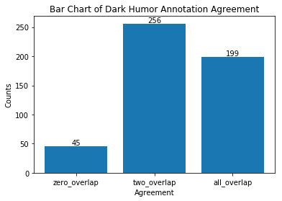
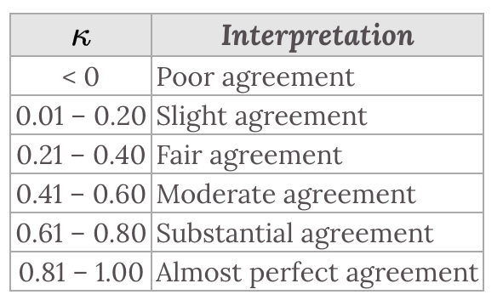
Annotation Results
Fleiss Kappa: 0.6696225078045701(Substantial agreement)

Slide 12
OCR,TM, P2V in MLPregressor
 | Model 1 (using SqueezeNet) |  | Model 2 (using Xception) |  | Model 3 (using resnet50)
 | R-squared | MSE | R-squared | MSE | R-squared | MSE
OCR | -0.06 | 0.08
Template_name(TM) | -0.05 | 0.07
Pic2vec(p2v) | -3.95 | 0.37 | -0.2 | 0.09 | -1.14 | 0.16
TM+P2V | -4.3 | 0.39 | -0.21 | 0.09 | -0.67 | 0.12
OCR+TM | 0.06 | 0.07
OCR+p2v | -3.84 | 0.36 | -0.12 | 0.085 | -0.17 | 0.09
OCR+TM+p2v | -1.81 | 0.21 | -0.13 | 0.086 | 0.07 | 0.07
Notes:
mlp = neural_network.MLPRegressor(hidden_layer_sizes=(100,100), activation="relu",
solver='lbfgs', alpha=0.01,
max_fun=1000,
early_stopping=True, validation_fraction=0.1,
max_iter=1000,tol=1e-4,random_state=0)

Slide 13
OCR,TM, P2V,Annox in MLPregressor
 | Model 1 (using SqueezeNet) |  | Model 2 (using Xception) |  | Model 3 (using resnet50)
 | R-squared | MSE | R-squared | MSE | R-squared | MSE
OCR+Annox | -0.11 | 0.08
Template_name(TM)+Annox | -0.26 | 0.09
Pic2vec(p2v)+Annox | -2.92 | 0.29 | -0.37 | 0.1 | -0.48 | 0.11
TM+P2V+Annox | -4.05 | 0.38 | -0.07 | 0.08 | -0.35 | 0.1
OCR+TM+Annox | 0.14 | 0.06
OCR+p2v+Annox | -3.93 | 0.37 | -0.09 | 0.08 | -0.14 | 0.08
OCR+TM+p2v+Annox | -4.35, -1.14 | 0.4, 0.15 | -0.02 | 0.07 | 0.12 | 0.06
Notes:
neg_mean_squared_error 是 (y-y')平方和的平均, 误差函数越大，模型越不好，所以Python自动在前面加 - 号， 越大表示误差越小，模型越好

Slide 14
 | Model 1 (using SqueezeNet) |  | Model 2 (using Xception) |  | Model 3 (using resnet50)
 | R-squared | MSE | R-squared | MSE | R-squared | MSE
OCR | -0.05 (+/- 0.06) | 0.091695
Template_name(TM) | -0.05 (+/- 0.06) | 0.09144548
Pic2vec(p2v) | -2.47 (+/- 2.01) | 0.29431671 | -0.12 (+/- 0.14) | 0.098201598 | -0.03 (+/- 0.06) | 0.090347553
TM+P2V | -1.24 (+/- 1.14) | 0.192785391 | -0.08 (+/- 0.07) | 0.094156843 | -0.08 (+/- 0.13) | 0.094283427
OCR+TM | -0.04 (+/- 0.08) | 0.091548441
OCR+p2v | -1.34 (+/- 0.95) | 0.2006552 | -0.10 (+/- 0.10) | 0.096135763 | -0.06 (+/- 0.09) | 0.093088024
OCR+TM+p2v | -0.70 (+/- 0.55) | 0.14824456 | -0.08 (+/- 0.08) | 0.09496993 | -0.05 (+/- 0.10) | 0.091656777
Notes:
MLPRegressor(activation='relu', alpha=0.01, batch_size='auto', beta_1=0.9,
beta_2=0.999, early_stopping=True, epsilon=1e-08,
hidden_layer_sizes=(100, 100, 100), learning_rate='constant',
learning_rate_init=0.001, max_fun=15000, max_iter=1000,
momentum=0.9, n_iter_no_change=10, nesterovs_momentum=True,
power_t=0.5, random_state=1, shuffle=True, solver='adam',
tol=0.0001, validation_fraction=0.1, verbose=False,
warm_start=False)

Slide 15
OCR,TM, P2V,Annox in MLPregressor 1002
 | Model 1 (using SqueezeNet) |  | Model 2 (using Xception) |  | Model 3 (using resnet50)
 | R-squared | MSE | R-squared | MSE | R-squared | MSE
OCR+Annox | -0.04 (+/- 0.07) | 0.09076144
Template_name(TM)+Annox | -0.03 (+/- 0.06) | 0.08980231
Pic2vec(p2v)+Annox | -2.33 (+/- 1.49) | 0.28639217 | -0.10 (+/- 0.11) | 0.09592243 | -0.05 (+/- 0.08) | 0.09205188
TM+P2V+Annox | -1.38 (+/- 2.89) | 0.20212338 | -0.11 (+/- 0.12) | 0.09660670 | -0.02 (+/- 0.07) | 0.08948317
OCR+TM+Annox | -0.07 (+/- 0.18) | 0.09346735
OCR+p2v+Annox | -1.22 (+/- 2.89) | 0.18807489 | -0.15 (+/- 0.13) | 0.10020844 | -0.03 (+/- 0.09) | 0.09026898
OCR+TM+p2v+Annox | -0.89 (+/- 0.77) | 0.16256248 | -0.12 (+/- 0.12) | 0.09763582 | -0.04 (+/- 0.07) | 0.090781506

Slide 16
Possible Reasons why R2 score is negative
Scaling of data: embedding 資料不用scale, Annox 0 or 1 也不用scale
Hyperparameter tuning: activation function, hidden layer, solver(adam, lbfgs)
Overfitting: Plot learning curve? lasso, ridge regularization regression

Slide 17
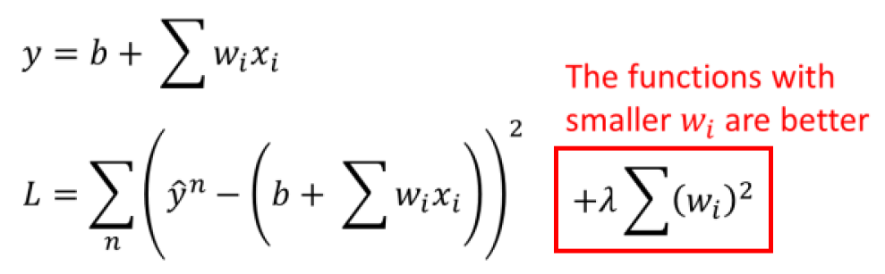
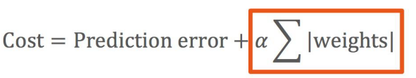
Lasso 和 Ridge 正規化回歸
為何使用:
用Regularization避免模型變得過於複雜，造成 Overfitting
well-suited for models showing high levels of muticollinearity (correlated predictor variables)
Regularization:
L1可以懲罰模型的複雜度，當模型愈複雜，其值就愈大, α 可以調整正則化的強度
Feature Selection:
遇到資料變數非常多時，Lasso模型是可以幫你識別並挑選出有最強（也最一致）訊號的變數, Ridge不行(可以看這裡)
Lasso:the coeﬃcients of less important features are reduced to zero.
https://datasciencebeginners.com/2018/11/26/using-scikit-learn-in-python-for-feature-selection/
L1

Slide 18
OCR,TM, P2V in Lasso Regression
 | Model 1 (using SqueezeNet) |  | Model 2 (using Xception) |  | Model 3 (using resnet50)
 | R-squared | MSE | R-squared | MSE | R-squared | MSE
OCR | 0.47 | 0.09
Template_name(TM) | 0.47 | 0.09
Pic2vec(p2v) | 0.20 | 0.10 | 0.28 | 0.11 | 0.21 | 0.12
TM+P2V | 0.20 | 0.10 | 0.28 | 0.11 | 0.40 | 0.09
OCR+TM | 0.63 | 0.06
OCR+p2v | 0.20 | 0.10 | 0.28 | 0.10 | 0.49 | 0.08
OCR+TM+p2v | 0.20 | 0.10 | 0.28 | 0.10 | 0.58 | 0.06
Notes:
kfold=5

Slide 19
OCR,TM, P2V,Annox in Lasso Regression
 | Model 1 (using SqueezeNet) |  | Model 2 (using Xception) |  | Model 3 (using resnet50)
 | R-squared | MSE | R-squared | MSE | R-squared | MSE
OCR+Annox | 0.48 | 0.08
Template_name(TM)+Annox | 0.49 | 0.07
Pic2vec(p2v)+Annox | 0.20 | 0.10 | 0.29 | 0.11 | 0.24 | 0.094
TM+P2V+Annox | 0.20 | 0.10 | 0.29 | 0.11 | 0.46 | 0.08
OCR+TM+Annox | 0.64 | 0.06
OCR+p2v+Annox | 0.20 | 0.10 | 0.30 | 0.10 | 0.50 | 0.07
OCR+TM+p2v+Annox | 0.20 | 0.10 | 0.30 | 0.10 | 0.57 | 0.06
Notes:
kfold=5

Slide 20
OCR,TM, P2V,Annox in Lasso Regression 1002
 | Model 1 (using SqueezeNet) |  | Model 2 (using Xception) |  | Model 3 (using resnet50)
 | R-squared | MSE | R-squared | MSE | R-squared | MSE
OCR+Annox | 0.00840907 | 0.11653279
Template_name(TM)+Annox | 0.005674709 | 0.10636153
Pic2vec(p2v)+Annox | 1.1102230246251565e-16 | 0.13524054 | 0 | 0.24754701 | 0.0030687 | 0.1277756
TM+P2V+Annox | 0 | 0.13525871 | 0 | 0.22184528 | 0.00306874 | 0.151415
OCR+TM+Annox | 0.00787647 | 0.1416664
OCR+p2v+Annox | 0 | 0.1353489 | 0 | 0.20649109 | 0.0030687 | 0.1662303
OCR+TM+p2v+Annox | 0 | 0.13538782 | 0 | 0.19388397 | 0.00306874 | 0.15547902

Slide 21
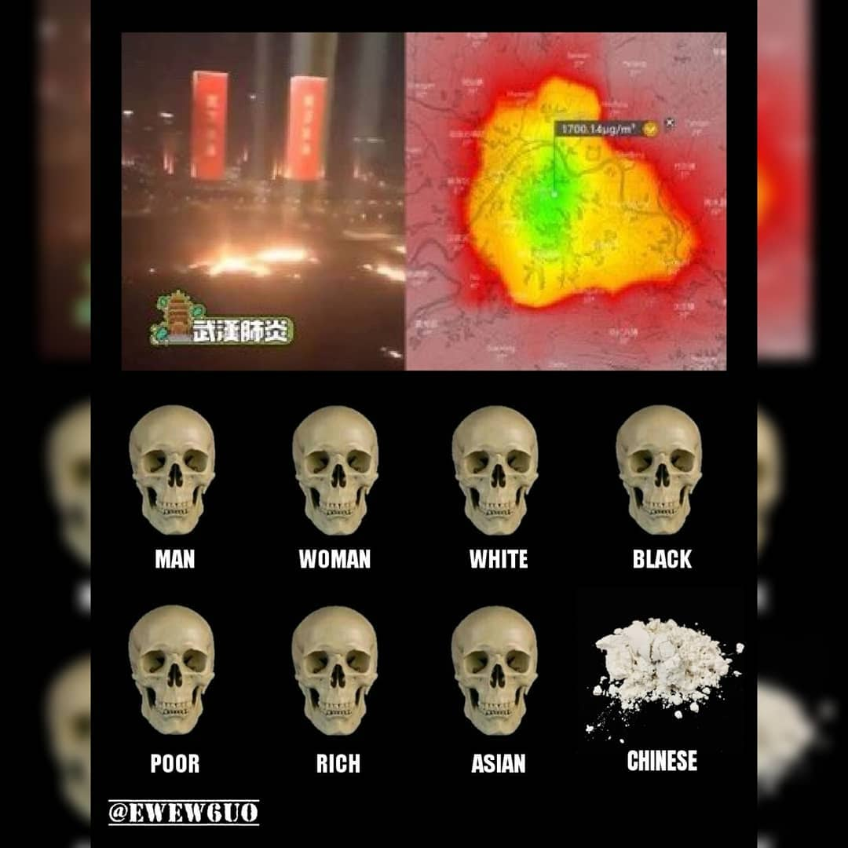
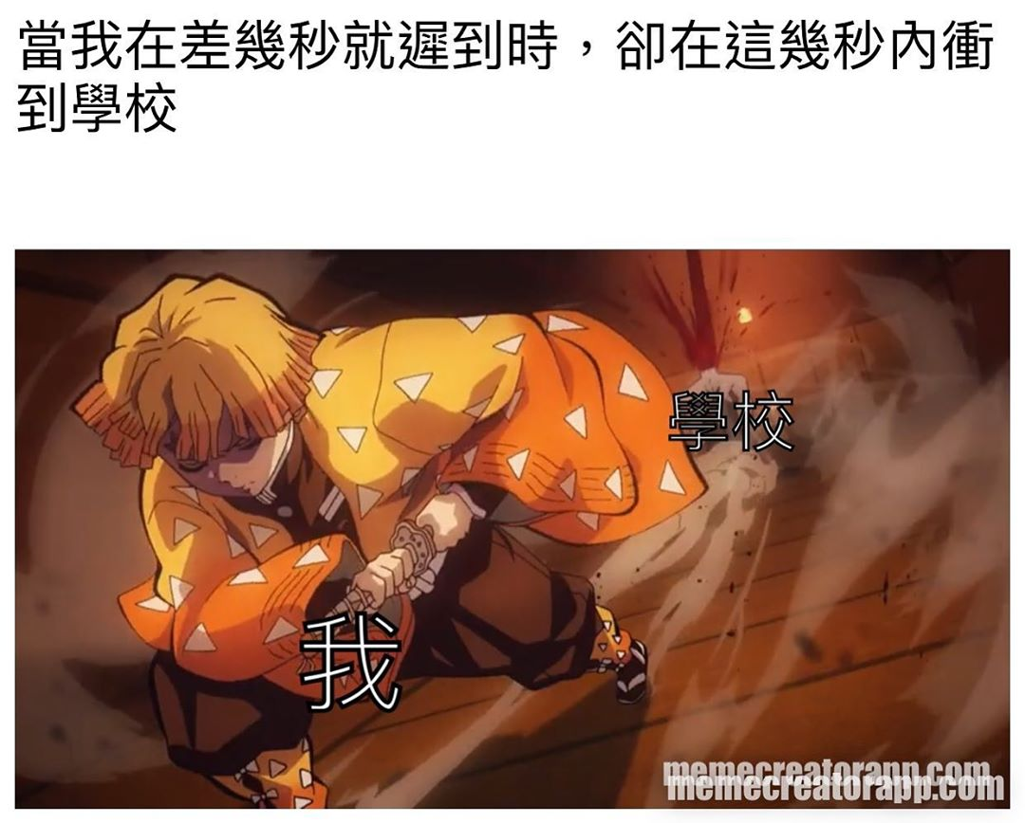
Sample Outputs: human ratings max & min
Dark humor prob: 0.63278
Human annotators ratings: 2,3,3(1)
Dark humor prob: 0.02419
Human annotators ratings: 0,0,0 (0)
Notes:
Lasso: x=ocr_tm_annox

Slide 22

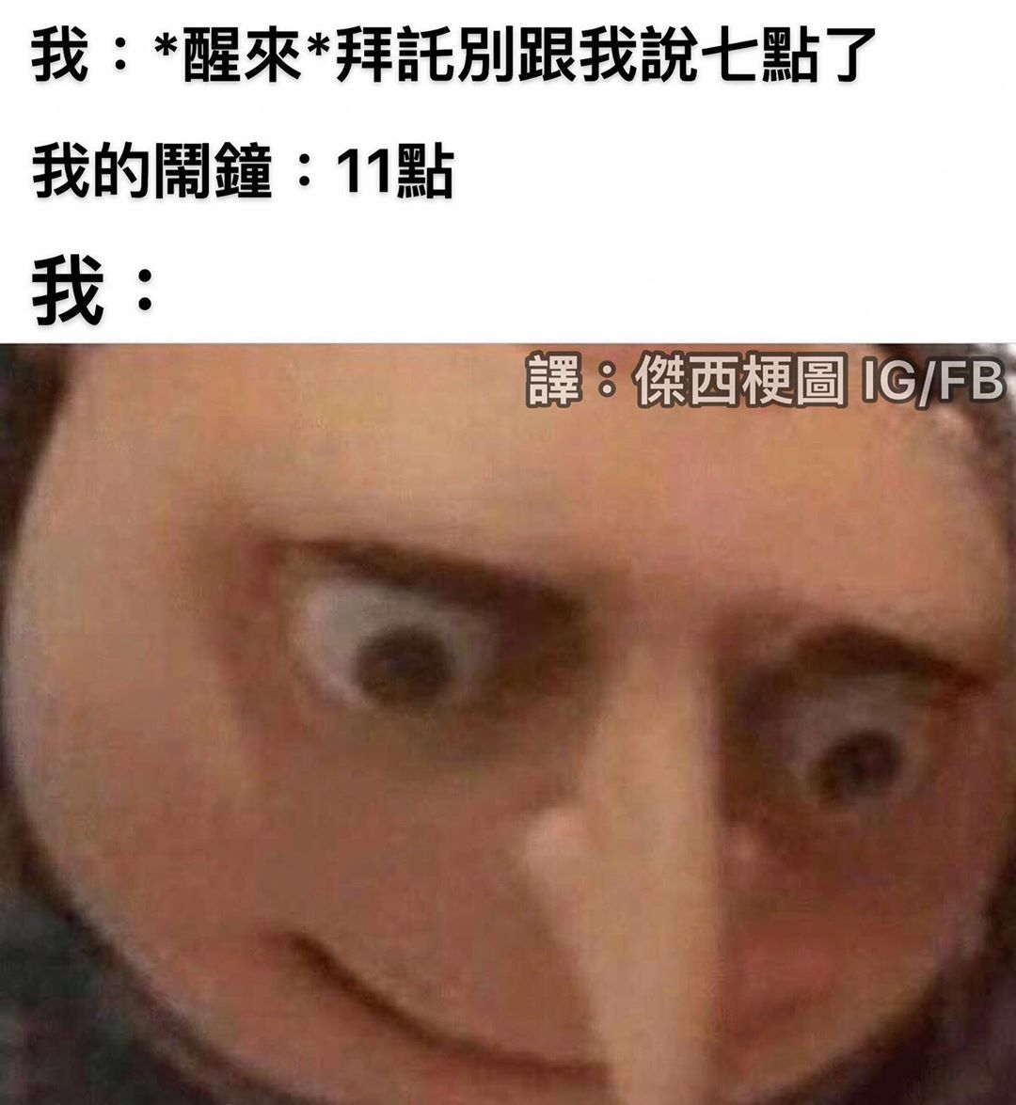
Sample Outputs: model prediction max & min
Dark humor prob: 0.84948
Human annotators ratings: 1,3,2 (0.66)
Dark humor prob: 0.00199
Human annotators ratings: 0,0,0(0)
Notes:
Lasso: x=ocr_tm_annox

Slide 23
A Cognitive Linguistics Approach: Multimodality, Language, Intertextuality, External Referencing
Memes Literacy:
(Zenner & Geeraerts 2018)
4 dimensions:
multimodality : image importance varies
multilingual: multilingual puns
intra-genre intertextuality
external referencing: allusions
(Procházka 2015)
Intertextuality
Anomalous juxtapositions: incongruity
EX:妹妹與火燒厝（Disaster Girl meme): juxtaposing a smiling girl with a burning house in the background, which intensifies the incongruity.
Creativity: global collaboration
Language: Net language
Conceptual Blending:
Integration of two visual/verbal inputs, then blend into one, providing new meaning (emergent space)
Construction: receive as whole
Creativity: participate in meaning construction
Construction Grammar:
(Dancygier & Vandelanotte 2017)
constructional compositionality: the possibility for salient parts of constructions to be sufficient to call up the full constructional meaning.
non-compositionality: 要全部一起看才了解意思

Slide 24
5/21進度
完成2~6章初稿，剩下第1章Introduction
中英文題目選定：
Predicting Dark Humor in Internet Memes: A Computational and Cognitive Approach
Multimodal Dark Humor Prediction: A Computational and Cognitive Approach
多模態黑色幽默預測分析：計算與認知觀點
以計算與認知觀點預測分析梗圖裡的黑色幽默

Slide 25
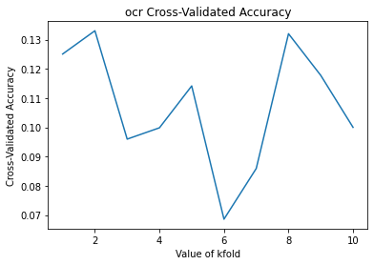
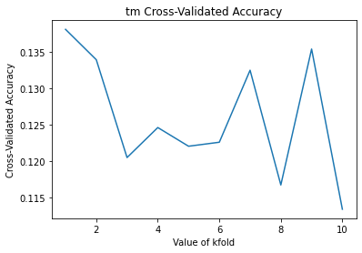
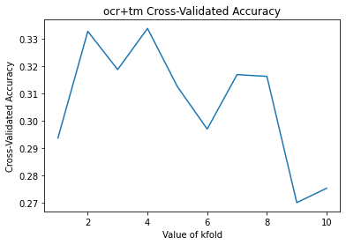
OCR, TM, P2V in MLPregressor1

Slide 26
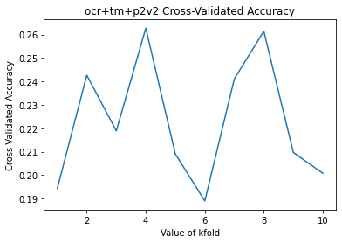
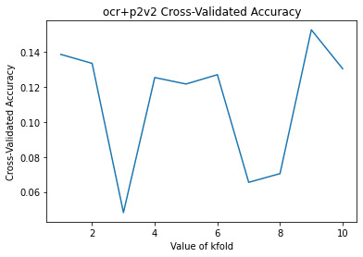
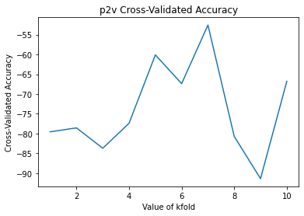
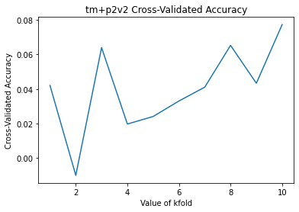
P2V

Slide 27
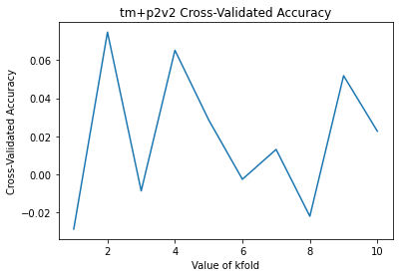
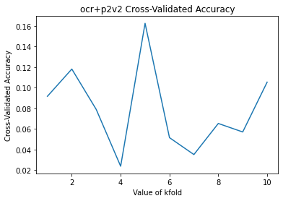

Slide 28
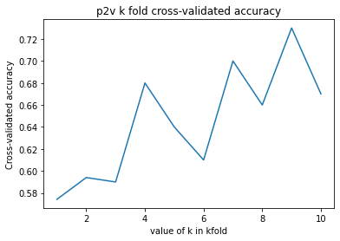
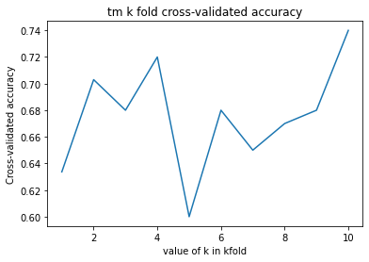
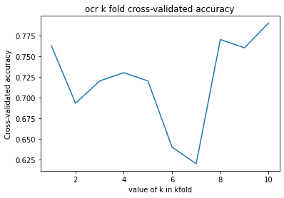
OCR,TM, P2V in MLPclassifier

Slide 29
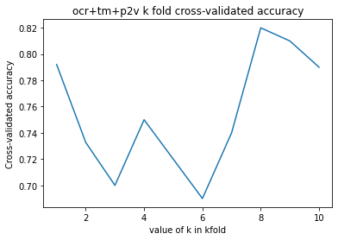
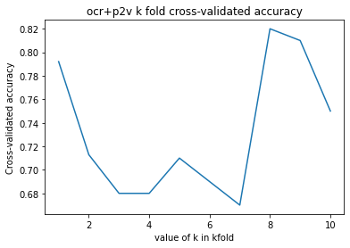
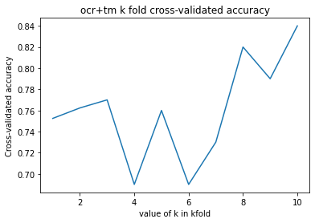
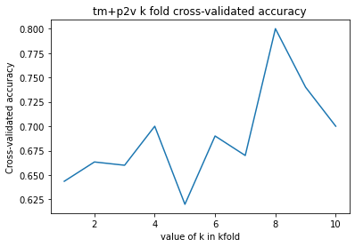

Slide 30
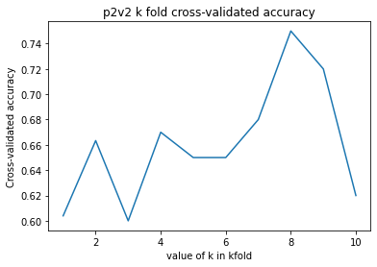
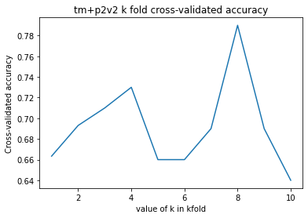
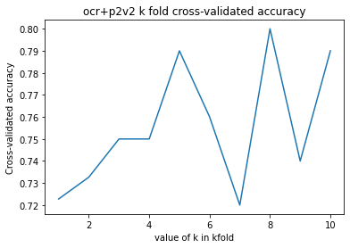
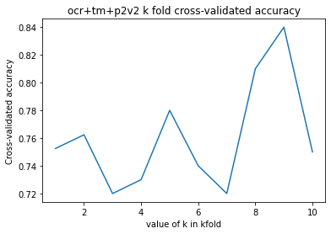

Slide 31
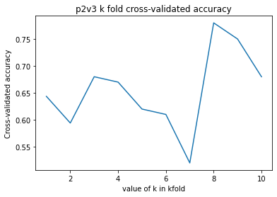
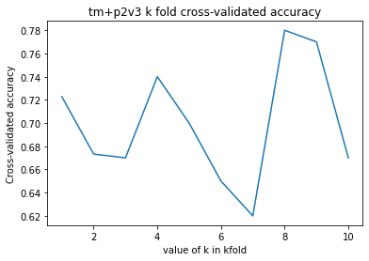
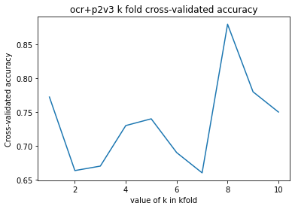
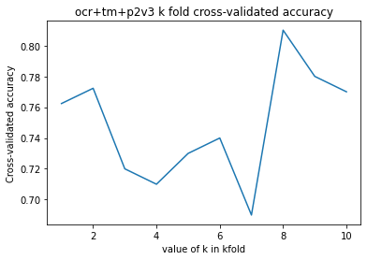

Slide 32
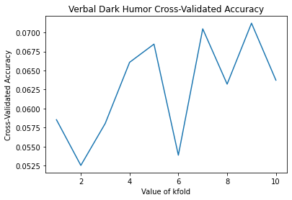
Verbal dh features in MLPregressor
scores cross val [-0.05204872 -0.03876177 0.04707275 0.06395023 0.01685573 0.04021454
0.16048873 0.04972114 0.08804761 0.03626943]
accuracy: 0.04 (+/- 0.11)

Slide 33
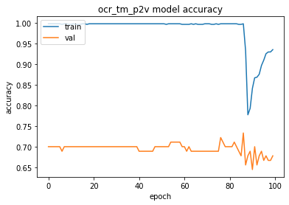
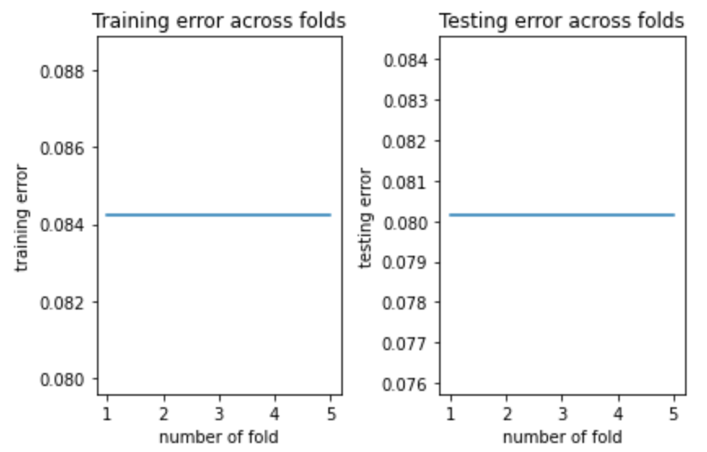
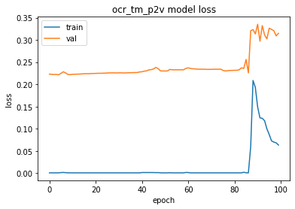
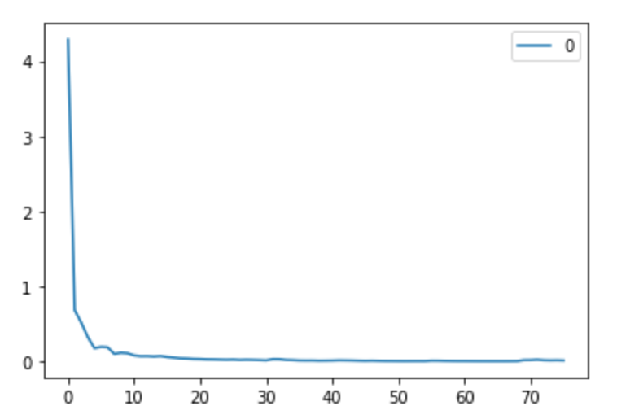
Plotting
Notes:
Train on 701 samples, validate on 63 samples(右圖)
one epoch = numbers of iterations = N = 訓練樣本的數量/batch_size

Slide 34
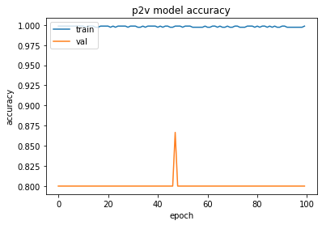
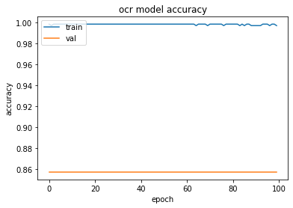
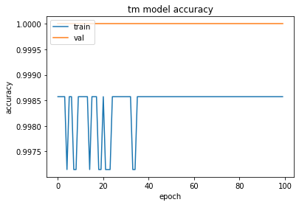
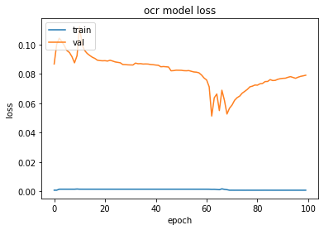
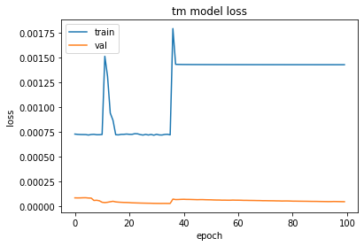
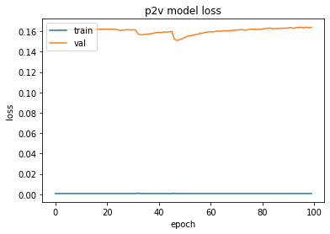

Slide 35
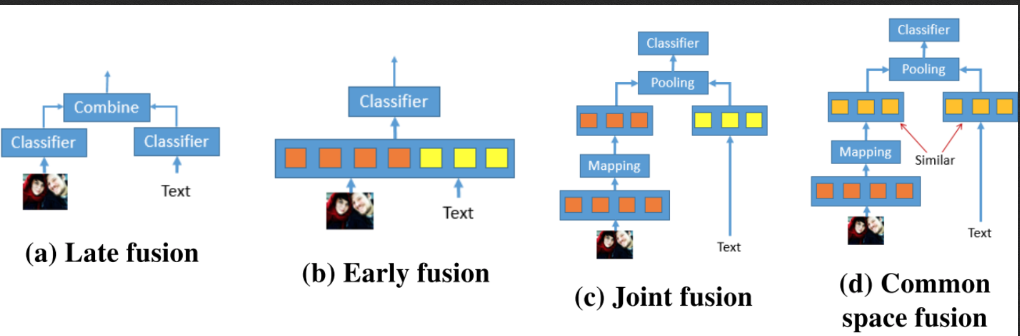
Concatenating vectors (Fusion Approaches):
Joint Fusion:
Mapping: to map the original image vector to a vector of the same dimension as the text vector
Pooling operation: the text and image vector obtain a combined feature vector (require both vectors to be of the same size)
Considers visual and textual representations as different, i.e., no relationship between them

Slide 36
Prediction Model
哪些features加入baseline?
Multiple Linear Regression (target variable?)
Deep Learning model/ MLP? (Multimodal hate speech detection 2019)
MLP多層感知器
A Multi-Layer Perceptron (MLP) with two Hidden Layers, Hidden size = 100. As we mentioned, hidden layers are the layers in a network that aren’t input or output. In other words, our classifier will have four layers. Input (size 4864), 2 hidden (size 100) and an output layer(size 1) (Multimodal hate speech detection 2019)

Slide 37
Literature
Poor indicator?
Fersini et al.2019: detecting sexist in memes (low level features)
Kolawole 2015: identifying memes & non-memes (lines, edges, and contrast or interest points such as blobs or corners)
Baseline study:
S`abat 2019: hate speech detection in memes (image embedding VGG16+BERT embedding)
Text only 66.0%, Image only 82.0%, Multimodal 82.0%

